Slide 1
THE JUDICIARY
CLASS 8

Slide 2
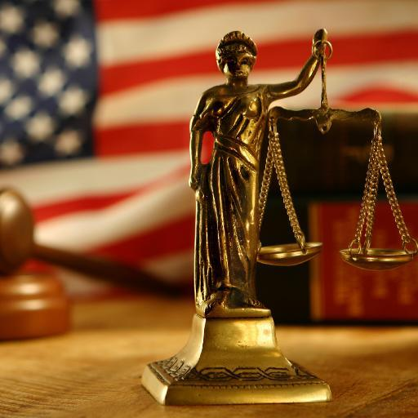
WHAT IS THIS?????

Slide 3
WHAT IS JUDICIARY???
It is the system of courts that interprets and applies the law in the name of the state.
The mechanism for the resolution of disputes.

Slide 4
ITS FUNCTIONS
It settles disputes between people, between the government and the people, between the state governments and between the state and the centre.
It upholds the rights of the citizens.
It interprets the constitution and has the power to declare a law null and void if it violates the principles of the constitution.

Slide 5
FEATURES OF THE JUDICIARY
Unified or Integrated Judiciary
Independence of the judiciary

Slide 6
UNIFIED OR INTEGRATED JUDICIARY
Courts are connected from the lowest to the highest levels.
If a person is not satisfied with the decision of the lower courts can appeal to the higher courts.
A higher court has the power to strike down or modify the decisions taken by lower courts.
Decisions of higher courts can be used as reference by lower courts in similar cases.
This ensures uniformity in justice.
Supreme court is the highest court in our country.

Slide 7
The courts below the high courts are known as SUBORDINATE COURTS.
They are further divided into-
CIVIL COURTS- it deals with the civil cases or disputes related to property, contracts, divorce etc.
It is filled by a person against another person.
CRIMINAL COURTS- it deals with criminal cases or crimes such as cheating, forgery, robbery and murder.
it is filled by the government against an accused person.
then the guilty is fined, punished or imprisoned and in some cases death sentence.

Slide 8
INDEPENDENT JUDICIARY
Functions without interference from the executive or the legislature is essential to ensure that every one is equal before law and has equal access to the constitutional remedies.
Power of judicial review- can strike down the laws and question the actions of the ministers and government functionaries.
It can use DIRECTIVES or orders to any authority or agency.
Can order government to pay compensation to the victims of injustice.

Slide 9
How to ensure independence??
1. executives cannot appoint judges.
2. removal of judges of high courts and supreme courts is done through the process of IMPEACHMENT. On the grounds of serious misbehavior or misuse of power. This is done by 2/3rd of the majority votes of the parliament.

Slide 10
THE STRUCTURE OF INDIAN JUDICIARY
SUPREME COURT
HIGH COURTS
SUBORDINATE COURTS

Slide 11
SUPREME COURT
It is the highest court , final court of appeal.
A person sentenced by the SC can appeal to the President for mercy.
COMPOSITION-
Headed by the CHEIF JUSTICE , who is appointed by the President in consultation with the judges of the SC and HC.
SC has 30 judges currently.
Conditions required for SC judge-
1. Indian citizen
2. 10 years of experience as HC judge
3. be a jurist
Can serve till the age of 65.

Slide 12
JURISDICTION-
The power or the authority of a court and the area within which it can exercise this authority.
Types-
ORIGINAL
APPELLATE
ADVISORY
SUPERVISORY

Slide 13
ORIGINAL JURISDICTION
MATTERS THAT CAN BE INTRODUCE ONLY IN THIS COURT.
Disputes between the central and the state governments.
Disputes between one or more state governments.
Cases related to constitutional validity of laws passed by Parliament.

Slide 14
APPELLATE JURISDICTION
Has power to hear appeals against the judgments of the lower courts.
Appeal against the judgment of HC.
Cases certified by HC as needing to be tried by SC.
Cases required interpretation of the constitution.
HC changes the sentenced passed by lower courts to a death sentence.
A review of its own judgment.

Slide 15
ADVISORY JURISDICTION
The SC advices the President on constitutional matters when asked by the President to do so.
This advice is not binding on the President.

Slide 16
SUPERVISORY JURISDICTION
It has supervisory jurisdiction over all the courts below it.
Can make rules for the and check their functioning.
COURT OF RECORD
KEEPS RECORD OF ALL THE DECISIONS.
USED AS REFERENCE BY THE LOWER COURTS.

Slide 17
HIGH COURT
The highest court in the state is the HC. At present there are 24 HC.
Some have jurisdiction over more than one state example- PUNJAB AND HARYANA HIGH COURT(CHANDIGARH), HC of HYDRABAD
(TELANGANA AND ANDHARA PARDESH).
COMPOSITION-
HC is headed by a Chief Justice who is appointed by the President with the consultation of the Governor of the state.
CONDITIONS-
Citizen of India
10 years of experience as an advocate of HC.
Servers till the age of 62.

Slide 18
JURISDICTION-
Disputes related to elections in the state.
Cases related to violation of rights.
Both civil and criminal cases are first filled in subordinate courts and then can be taken up by the HC. It has appellate jurisdiction all over such cases.
It has supervisory jurisdiction over the lower courts.
It also has its court of records.

